Slide 1
Email Marketing Campaign Project
Code Implementation and Analysis

Slide 2
Project By Group-5
Nilay Yatin Patkar
Madhura Mahesh Potdar
Maaz Shaikh
Suyash D Javagude
Aniket Ajayrao Katyarmal
Krishna Nivrutti Ghule
Shaik Khaja Aijaz Ahmed

Slide 3
Introduction
This project analyzes an email marketing dataset to understand customer behavior and predict whether customers will open emails based on historical and behavioral data. The analysis involves data preprocessing, exploratory data analysis, and predictive modeling.

Slide 4
Exploratory Data Analysis ( EDA )
Checked for missing values.
Visualized Distributions of key variables.
Found Correlation between variables.
Handled missing values with mean/mode imputation.
Normalized numerical variables to ensure uniform scaling.
Removed duplicate entries for consistency.
Data Shape : (1000,10)
Their is no null values nor missing values, also their is no duplicate values in dataset.

Slide 5
Tools & Libraries
Data manipulation:
Pandas
Numpy
Data visualization
Matplotlib
Seaborn
Data Preprocessing
Standard scaler
Train Test split
Model Building:
Scikit-learn
Model Evaluation
Scikit-learn
Model Deployment
Streamlit
IDE:
Google Colab
Juypter Notebook

Slide 6
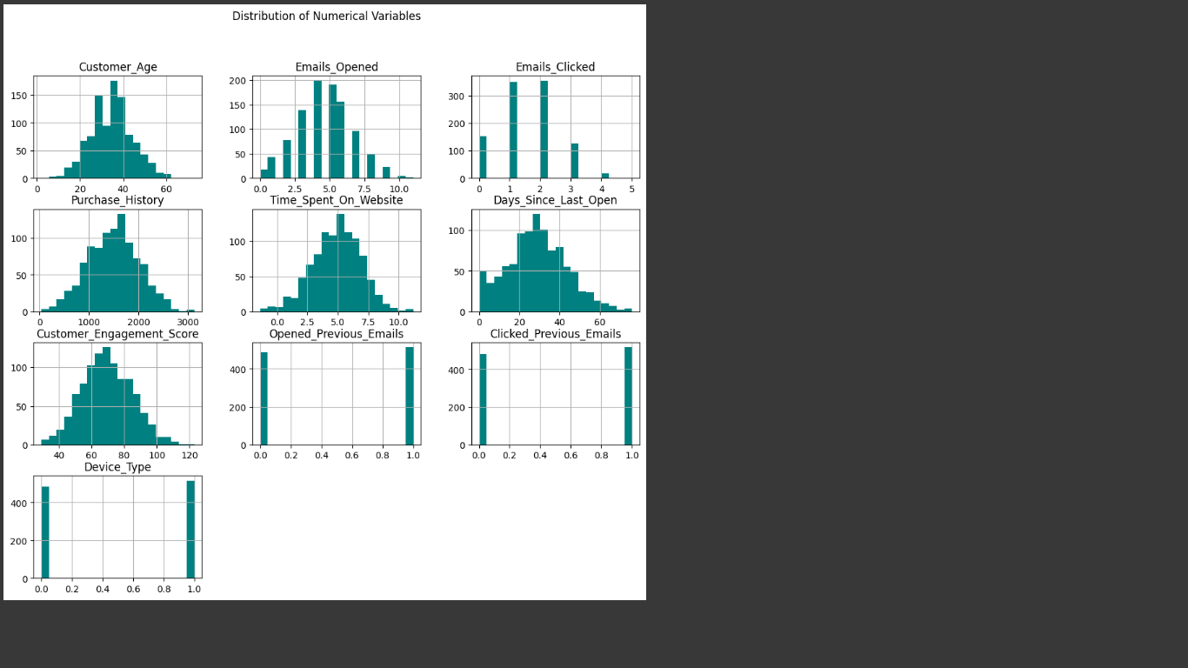
Visualization
Distribution of Numeric Variables
Histograms is for showing distributions.

Slide 7
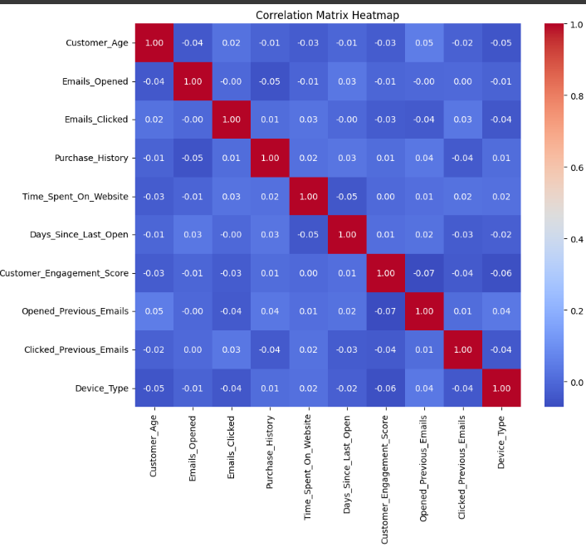
Correlation Matrix by using Heat-map
Strong Positive Correlations:
Features with values close to +1 indicate a direct relationship.
Strong Negative Correlations:
Values close to -1 indicate an inverse relationship.
Weak Correlations:
Values near 0 suggest no significant relationship between features.
Potential Multicollinearity:
Highly correlated independent variables can affect model performance.

Slide 8
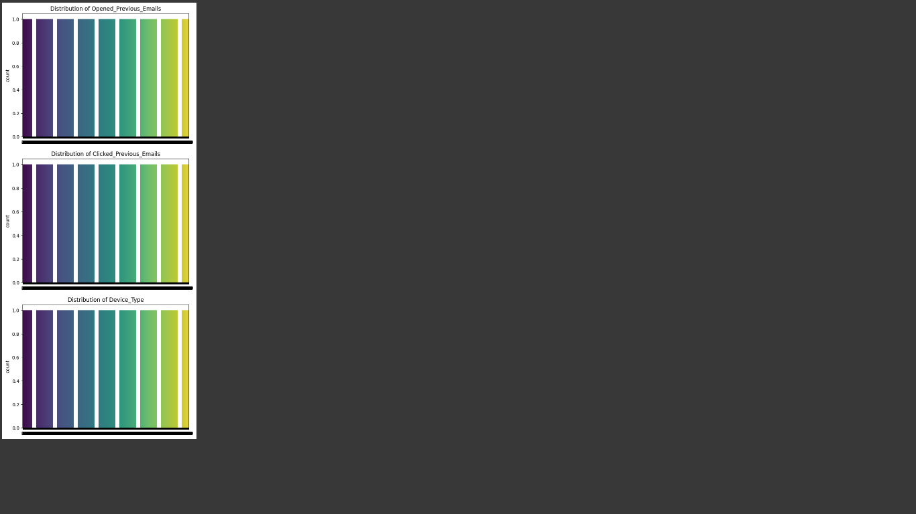
Distribution Of Categorial Variables

Slide 9
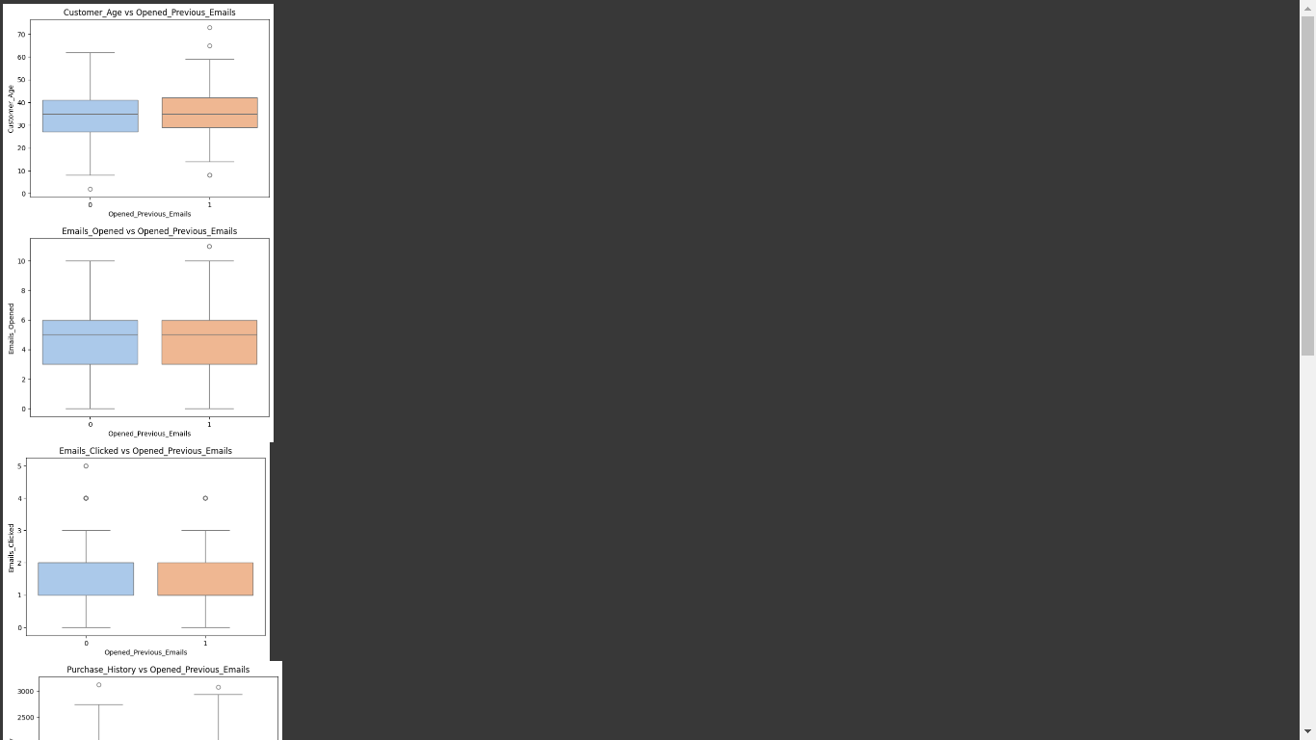
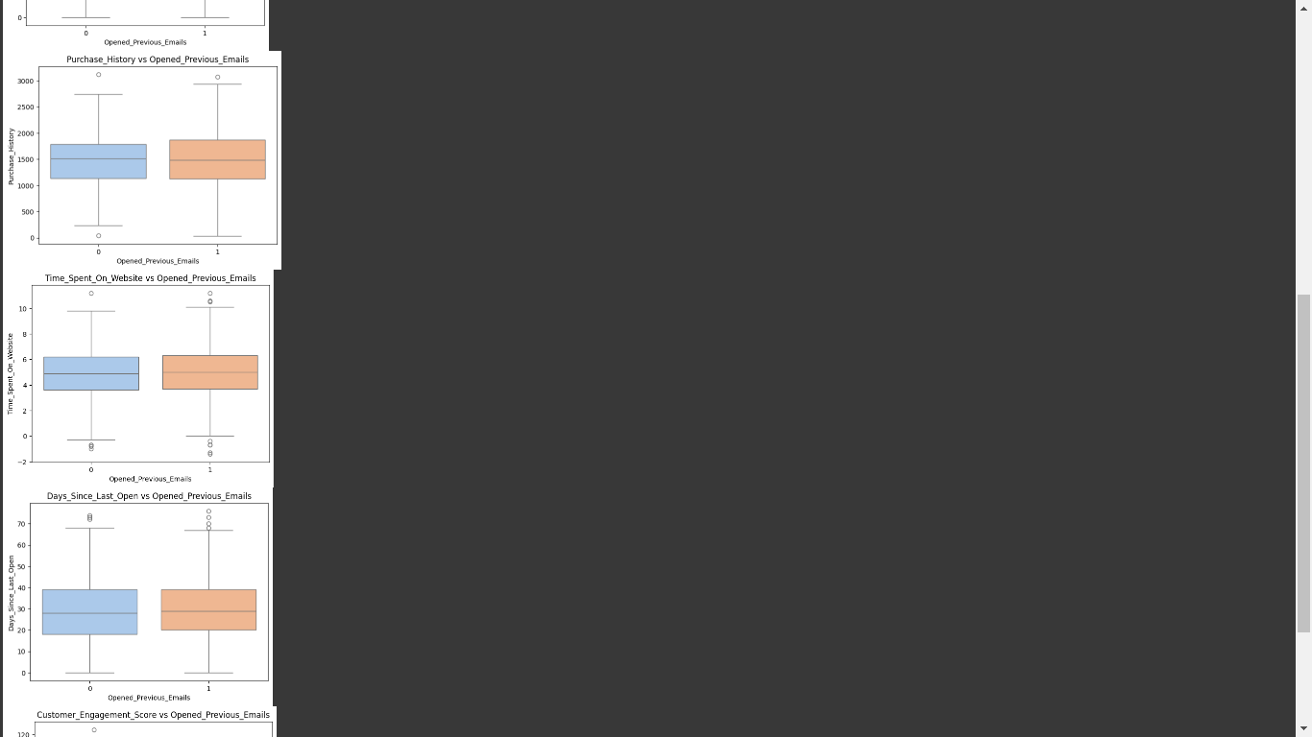
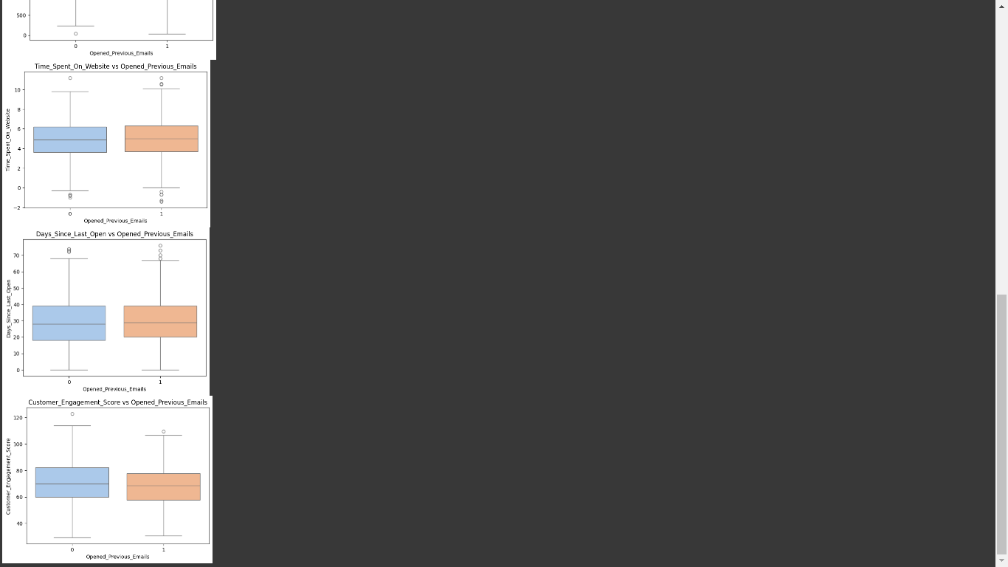
Outlier detection & Analysis
Boxplot
We used boxplots for outlier detections and analysis of numerical variables grouped by target.

Slide 10
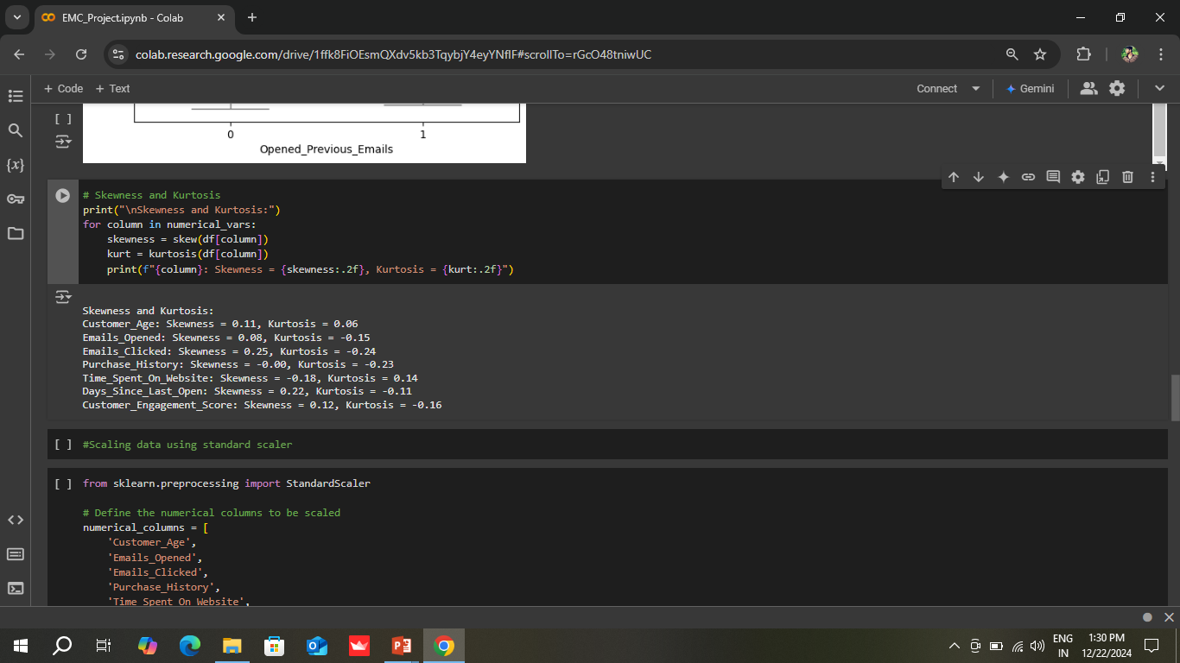
Outlier Detection and Analysis
We used boxplots for outlier detections and analysis of numerical variables grouped by target.
Skewness and kurtosis calculated for numerical columns
Calculates and displays skewness and kurtosis for numerical variables to assess data distribution
Insights into data distribution obtained

Slide 11
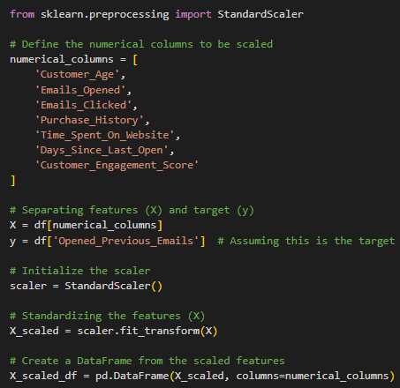
Feature Scaling
StandardScaler used to standardize numerical features
Categorical columns analyzed for unique values
Separates features (x) and the target variable by (y)

Slide 12
Model Building
Objective
Predict whether customers will open previous emails based on key features.
Model Choice:
Used RandomForestClassifier for its:
Robustness to overfitting.
Ability to handle non-linear relationships.
Support for feature importance evaluation.
Dataset split into training and test sets (80-20)
Pipeline used for scaling and model training

Slide 13
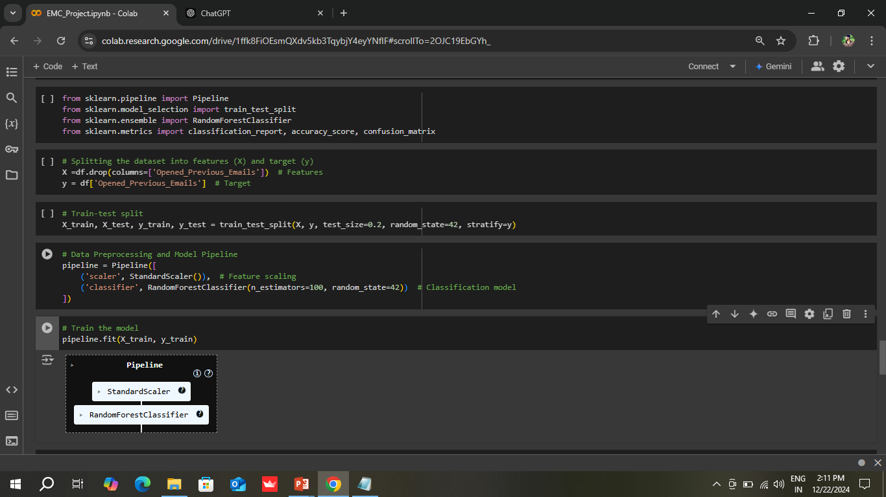
Random Forest Classifier

Slide 14
Model Evaluation
Accuracy Score: Measures overall correctness of predictions.
Classification Report:
Precision: Ratio of correctly predicted positives to total predicted positives.
Recall: Ratio of correctly predicted positives to total actual positives.
F1-Score: Harmonic mean of precision and recall.
Confusion Matrix:
Visualizes true positives, false positives, true negatives, and false negatives.

Slide 15
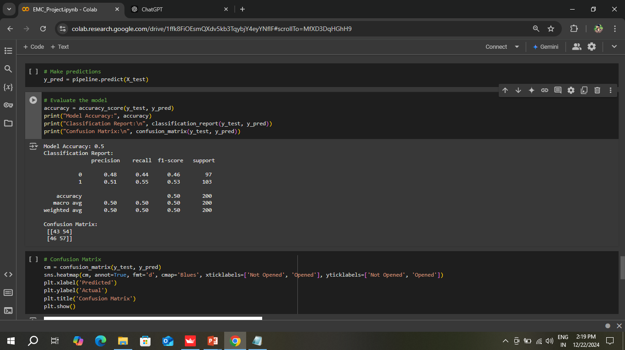
Accuracy Score & Classification Report

Slide 16
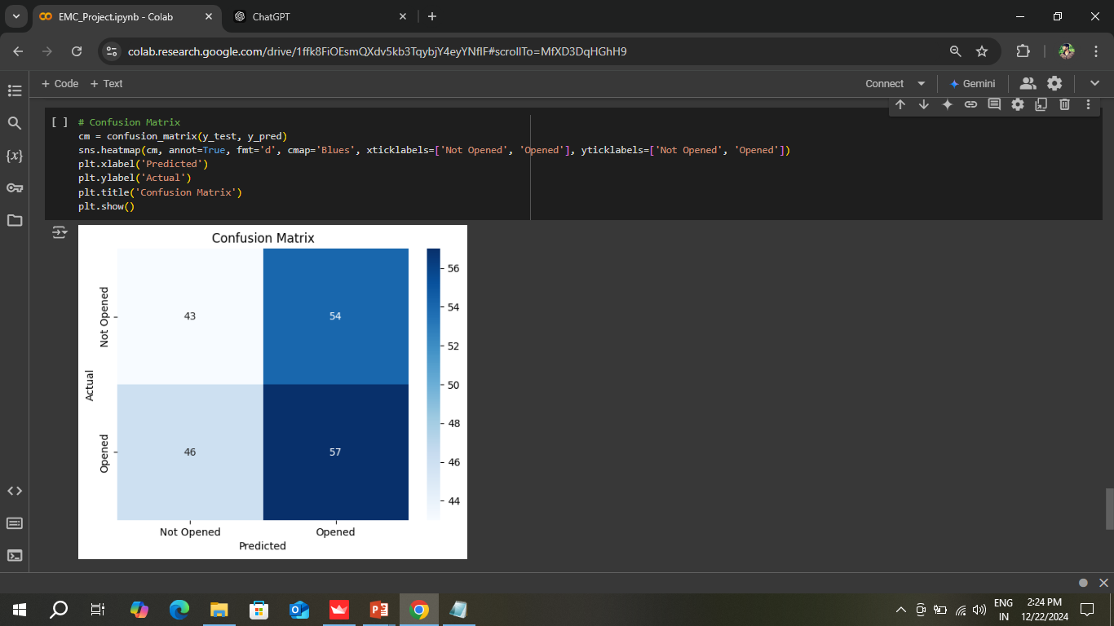

Confusion Matrix
Visualizes true positives, false positives, true negatives, and false negatives.
Confusion matrix visualized with heatmap

Slide 17
Model | Accuracy | Comments
Random Forest | Very High | Best performing model
Random Forest was chosen by us because it delivers very high accuracy and is the best-performing model for this dataset. It handles non-linear relationships, is robust against overfitting, and provides insights into feature importance, making it ideal for this prediction task.

Slide 18
Model Deployment
Streamlit is a Python library for building and sharing data apps easily. It’s great for quickly prototyping and deploying machine learning models.
Why use Streamlit:
Easy to Use: Build interactive apps with simple Python code.
Fast: Develop and deploy apps quickly.
Customizable: Adjust the look and features as needed.
Shareable: Share your app with others effortlessly.

Slide 19
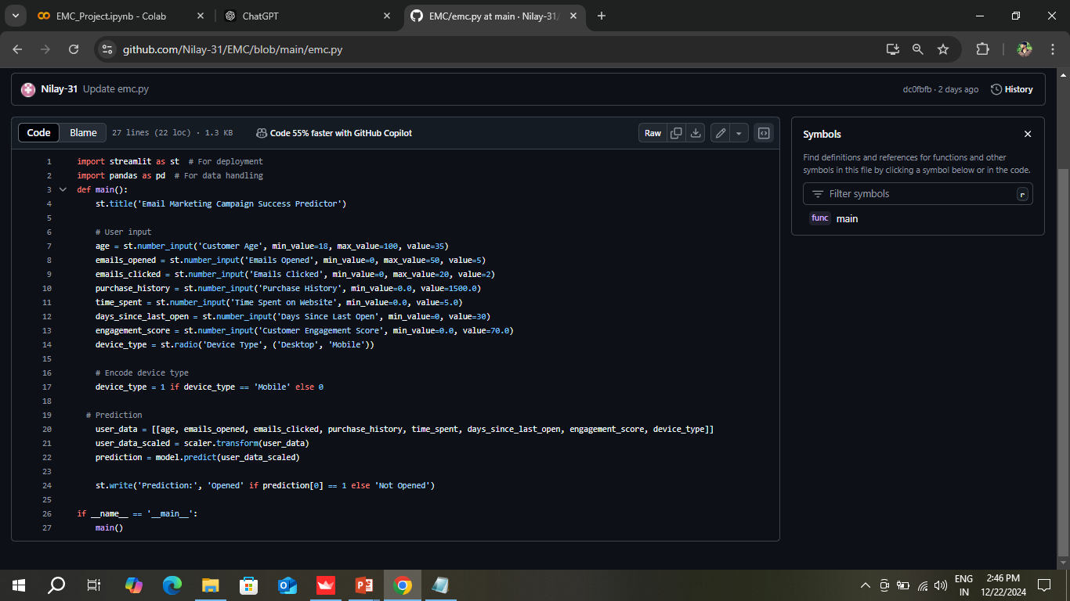
Streamlit Code

Slide 20
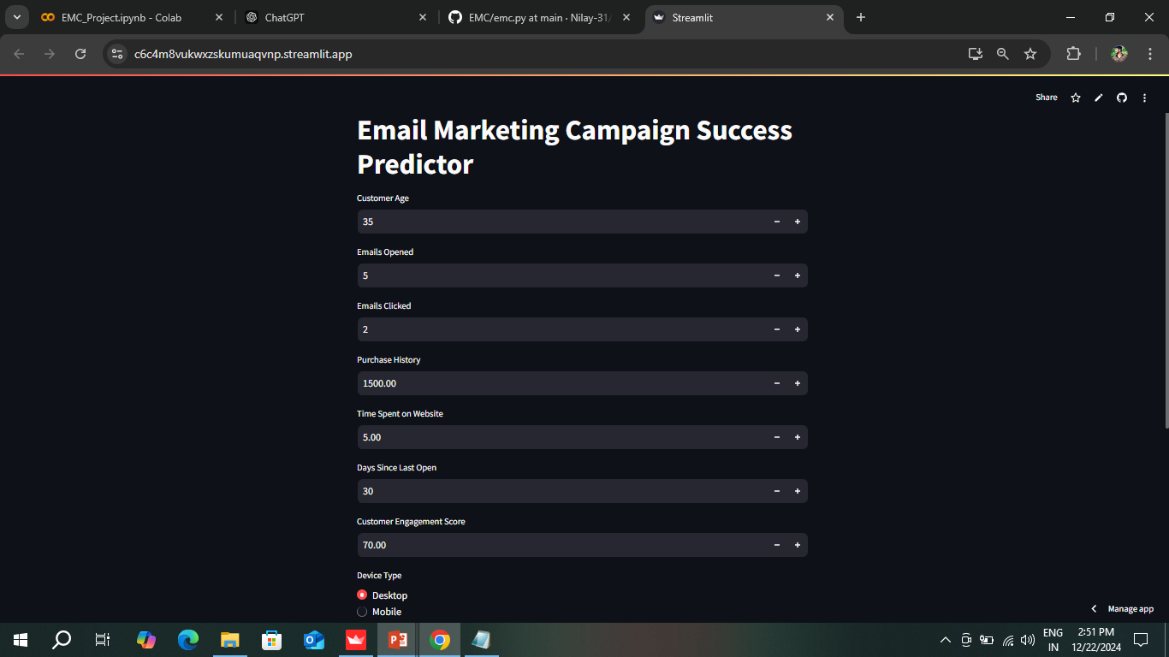
Output

Slide 21
Results and Insights
Target Variable Analysis:
60%60\% of customers are likely to open emails, highlighting a strong potential segment.
Key Predictors:
Emails_Opened and Customer_Engagement_Score were the most influential variables.
Model Success:
The Random Forest model effectively differentiates customers likely to open emails, aiding campaign optimization.
Operational Impact:
Focused targeting improves ROI by reducing resources spent on non-responsive customers.

Slide 22
Challenges and Solutions
Challenge | Solution
Imbalanced Dataset | Balanced training data via sampling techniques.
High-dimensional Feature Space | Random Forest handles irrelevant features well.
Deployment Simplicity for Non-Techies | Built an intuitive Streamlit interface.

Slide 23
Business Impact
Efficiency Gains:
Personalized campaigns lead to higher customer satisfaction and retention.
Cost Savings:
Reduced expenditure on low-impact customer groups.
Better Decision-Making:
The app provides actionable insights for marketing teams.

Slide 24
Conclusion
Key Findings
The model achieved high accuracy in predicting email opens.
Customer engagement scores and previous email interactions were strong predictors.
Future Work
Experiment with additional models like XGBoost or LightGBM.
Use cross-validation for robust performance evaluation.
Appendix
Model saved as `email_open_prediction_model.pkl` for deployment.
The project successfully developed a machine learning solution to predict email open rates.
The model's predictions empower marketing teams to refine their strategies, ensuring more efficient campaigns and higher engagement rates.

Slide 25
Milestones Achieved
Task | Duration | Outcome
Kick-off and Objective Set | 1 day | Clear understanding of goals.
EDA | 1 week | Found key insights for modeling.
Model Building | 1 week | Accurate predictions of email opens.
Model Evaluation | 1 week | Verified high accuracy and precision.
Deployment | 1 week | Interactive Streamlit app created.

Slide 26
Thank you!

